Slide 1
OOPS 4
MULTITHREADING AND ABSTRACTION
LECTURE 6
ANURADHA SAHU
SENIOR FACULTY

Slide 2
JAVA THREAD
A thread in Java is the direction or path that is taken while a program is being executed.
Generally, all the programs have at least one thread, known as the main thread,
that is provided by the JVM or Java Virtual Machine at the starting of the program’s execution.
At this point, when the main thread is provided,
the main() method is invoked by the main thread.

Slide 3
A thread in Java can be created in the following two ways:
Extending java.lang. Thread class
Implementing Runnable interface

Slide 4
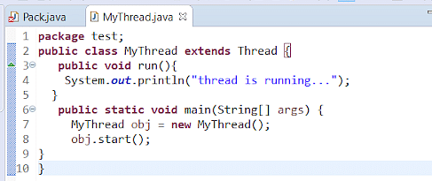
ACTIVITY-1
Extending java.lang. Thread class

Slide 5
OUTPUT
Thread is running

Slide 6
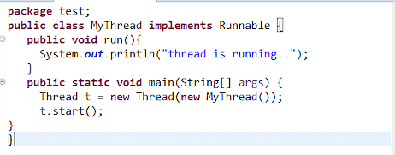
ACTIVITY-2
Implementing Runnable interface

Slide 7
OUTPUT
Thread is running.

Slide 8
MULTITHREADING
Multithreading in Java
It is a process of executing multiple threads simultaneously.
A thread is a lightweight sub-process, the smallest unit of processing.
Multithreading is used to achieve multitasking.
Multithreading is mostly used in games ,animations etc.

Slide 9
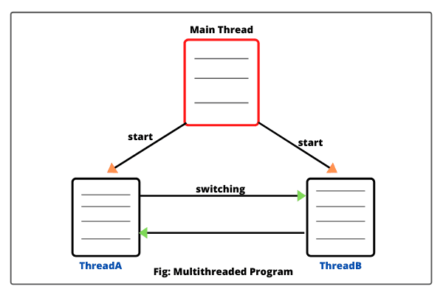
DIAGRAMATIC REPRESENTATION

Slide 10
EXAMPLE
Multithreading enables us to run multiple threads concurrently.
For example
in a web browser,
we can have one thread which handles the user interface,
and in parallel we can have another thread which fetches the data to be displayed.
So multithreading improves the responsiveness of a system.

Slide 11
PDF LINK FOR MULTITHREADING PROGRAMS
https://www.tutorialspoint.com/java/pdf/java_multithreading.pdf

Slide 12
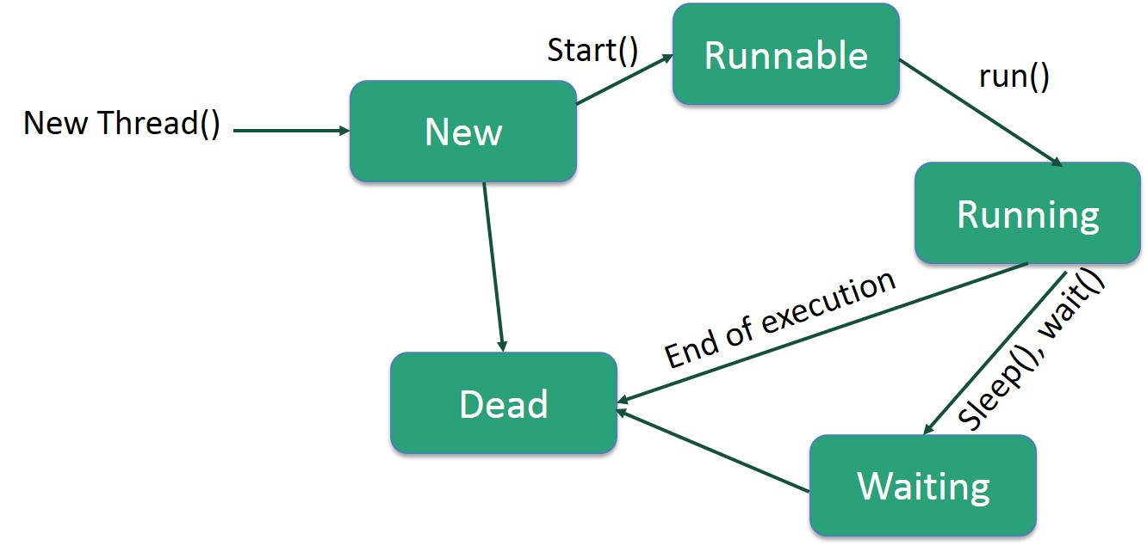
THREAD LIFE CYCLE

Slide 13
STAGES OF THREAD LIFE CYCLE
New − A new thread begins its life cycle in the new state.
It remains in this state until the program starts the thread.
It is also referred to as a born thread.
Runnable − After a newly born thread is started, the thread becomes
runnable. A thread in this state is considered to be executing its task.
Waiting − Sometimes, a thread transitions to the waiting state while the
thread waits for another thread to perform a task. A thread transitions back to
the runnable state only when another thread signals the waiting thread to
continue executing.

Slide 14
Timed Waiting − A runnable thread can enter the timed waiting state for a
specified interval of time. A thread in this state transitions back to the
runnable state when that time interval expires or when the event it is waiting
for occurs.
Terminated (Dead) − A runnable thread enters the terminated state when it
completes its task or otherwise terminates.

Slide 15
Final,finally,finalize
The final keyword can be used with class method and variable. ...
The finally keyword is used to create a block of code that follows a try block. ...
The finalize() method is used just before object is destroyed and can be called
just prior to object creation.

Slide 16
COMPARISON
Factor | Final | Finally | Finalize
Definition | Final is a keyword and is used as access modifier in Java | Finally is a block in Java used for Exception Handling | Finalize is a method in Java used for Garbage Collection
Application | Final in Java is used with variables, methods, and classes to set access permissions | Finally block is used along with a try and catch block | Finalize method in Java is used with objects which are no longer in use
Function | Final variable in Java is a constant whose value can’t be changed once assigned. Final method in Java can’t be overridden by its child classes. Final class in Java can’t be inherited by any child class. | Finally block in Java helps in cleaning up the resources that have been used in the try block | Finalize method helps in clean up activities for the object before it is destroyed by the garbage collector
Execution | It is executed when it is invoked by the compiler | Executes right after the execution of try-catch block | It executes just before an object is destroyed

Slide 17
GARBAGE COLLECTION
Garbage collection in Java is the process by which Java programs perform automatic memory management.
An object is marked for garbage collection if there are more references to it.
You can explicitly drop a variable reference by pointing it to null.
The garbage collector first identifies such objects and marks them ,then sweep them from memory. This is called mark sweep process.
The garbage collector is called automatically.
There is no guaranty that it will execute in your program’s lifetime.

Slide 18
We can also request JVM to run Garbage Collector
Using System.gc() method: System class contain static method gc() for requesting JVM to run Garbage Collector.
Using Runtime.getRuntime().gc() method:
Runtime class allows the application to interface with the JVM in which the application is running. Hence by using its gc() method, we can request JVM to run Garbage Collector.
There is no guarantee that any of the above two methods will run Garbage Collector.
The call System.gc() is effectively equivalent to the call : Runtime.getRuntime().gc()

Slide 19
EXAMPLE
Person
{
int id;
String name;
//Overriding finalize
protected void finalize()
{
System.out.println(“Trisect”);
}

Slide 20
Person p; // code 1
System.gc();
System.out.println(“Hello”);
Person p = new Person();
p=null; //code 2
System.gc();
System.out.println(“Hello”);

Slide 21
OUTPUT
Output 1:
Hello
No initialization, no object in memory nothing to garbage collect.
Output 2:
Hello
Trisect
Dereferenced object p (by pointing it to null).Hence, finalize method is called. However, finalize executes after it.

Slide 22
ABSTRACTION
In simple terms, abstraction “displays” only the relevant attributes of objects
and “hides” the unnecessary details.
. For example,
when we are driving a car, we are only concerned about driving the car like
start/stop the car, accelerate/ break, etc.

Slide 23
NEED OF THE ABSTRACTION
The main purpose of abstraction is hiding the unnecessary details from the
users.
It helps in reducing programming complexity and efforts.
It is one of the most important concepts of OOPs

Slide 24
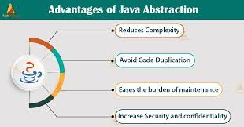

Slide 25
WAYS TO ACHIEVE ABSTRACTION
There are the two ways to achieve abstraction:
Abstract class
Interface

Slide 26
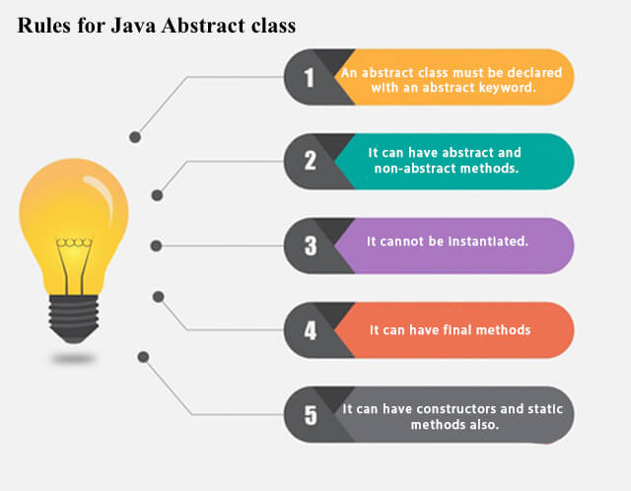
ABSTRACT CLASS

Slide 27
SYNTAX OF THE ABSTRACT CLASS
//Syntax:
<Access Modifier> abstract class <Class_name> {
//Data_Members;
//Statements;
//Methods;
}

Slide 28
ACTIVITY-3
abstract class Bike{
abstract void run();
}
class Honda4 extends Bike{
void run()
{
System.out.println("running safely");
}
public static void main(String args[]){
Bike obj = new Honda4();
obj.run();
}
}

Slide 29
OUTPUT
Running safely

Slide 30
INTERFACES
In Java, an interface is a reference type similar to a class that can contain only
constants, the method signatures, default methods, and static methods,
and Its Nested types.
In interfaces, method bodies exist only for default methods and static methods.

Slide 31
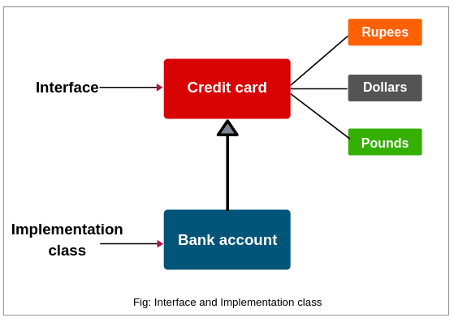
INTERFACE EXAMPLE IN REAL LIFE

Slide 32
SYNTAX
interface {
// declare constant fields
// declare methods that abstract
// by default.
}

Slide 33
ACTIVITY -4
interface car
{
void display();
}
class model implements car
{
public void display()
{
System.out.println("im a Car");
// the code output will print "im a car"
}
public static void main(String args[])
{
model obj = new model();
obj.display();
}
}

Slide 34
OUTPUT
I m a car

Slide 35
PROGRAMMING QUESTIONS
Write a program to read and display of a matrix.

Slide 36
ALGORITHM
Initialize the rows , columns and array of the matrix.
int a[][]=new int[3][3];
Use nested for loop to read the array.
Then
Again use the nested for loop to display the matrix.

Slide 37
Write a Program to find the addition of two matrices.

Slide 38
ALGORITHM
Initialize row, column, matrix [rows][columns],sum
Use nested for loop to read the matrix 1
Use nested for loop to read the matrix 2
Use nested for loop to sum the elements of both the matrix.
Then print the sum.

Slide 39
Write a program to find the sum of elements in 2d array.

Slide 40
ALGORITHM
Initialize the matrix[rows][columns],rows , columns , sum
Use the nested loop to read the matrix.
Use the nested loop to sum the elements of the matrix.
Print sum.

Slide 41
SPECIAL PROGRAMMING QUESTIONS
A Java interface can only contain method signatures and fields. The interface can be used to achieve polymorphism. In this problem, you will practice your knowledge on interfaces.
You are given an interface AdvancedArithmetic which contains a method signature int divisor_sum(int n). You need to write a class called MyCalculator which implements the interface.
divisorSum function just takes an integer as input and return the sum of all its divisors. For example divisors of 6 are 1, 2, 3 and 6, so divisor_sum should return 12. The value of n will be at most 1000.
Read the partially completed code in the editor and complete it. You just need to write the MyCalculator class only. Your class shouldn't be public.

Slide 42
Sample Input
6
Sample Output
I implemented: AdvancedArithmetic 12
Explanation
Divisors of 6 are 1,2,3 and 6. 1+2+3+6=12.

Slide 43
ASSIGNMENT
Write a program in java for multiplication and subtraction of matrix.
Practice special questions from hackerearth.

Slide 44
INTERVIEW QUESTIONS OF MULTITHREADING
What are the benefits of using multithreading?
What is thread in Java?
What are the two ways of implementing thread in JAVA ?
Explain the life cycle of thread?
Why wait(), notify(), and notifyAll() methods are present in Object class?
What is the start() and run() method of Thread class?
Explain garbage collection.

Slide 45
ANSWER SLIDES
There are various benefits of multithreading as given below:
Allow the program to run continuously even if a part of it is blocked.
Improve performance as compared to traditional parallel programs that use multiple processes.
Allows to write effective programs that utilize maximum CPU time
Improves the responsiveness of complex applications or programs.
Increase use of CPU resources and reduce costs of maintenance.
Saves time and parallelism tasks.
If an exception occurs in a single thread, it will not affect other threads as threads are independent.
Less resource-intensive than executing multiple processes at the same time.

Slide 46
Refer slide
Refer slide
Refer slide
We know that every object has a monitor that allows the thread to hold a lock on the object. But the thread class doesn't contain any monitors. Thread usually waits for the object’s monitor (lock) by calling the wait() method on an object, and notify other threads that are waiting for the same lock using notify() or notifyAll() method. Therefore, these three methods are called on objects only and allow all threads to communicate with each that are created on that object

Slide 47
start(): In simple words, the start() method is used to start or begin the execution of a newly created thread. When the start() method is called, a new thread is created and this newly created thread executes the task that is kept in the run() method. One can call the start() method only once. run(): In simple words, the run() method is used to start or begin the execution of the same thread. When the run() method is called, no new thread is created as in the case of the start() method. This method is executed by the current thread. One can call the run() method multiple times.
Refer slide

Slide 48
INTERVIEW QUESTIONS ON ABSTRACTION
How Abstraction is helpful in java?
What are the advantages of Abstraction?
How Abstraction is achieved in java?
When to use abstract class in Java?
When to use the abstract method in Java?
What are the differences between Abstraction and Encapsulation?
What are the difference between Abstraction and Polymorphism?
What are interfaces in Java?
Difference between Abstract class and Interface in java?
Can abstract method can be defined inside the non-abstract class?
Should abstract methods be overridden?
Is it possible for one interface to extend another?

Slide 49
ANSWER SLIDES
Abstraction is one of the main concepts of OOPS(Object-oriented program). Abstraction is very much useful in Java as it reduces the complexity and efforts of programming from selecting Data from the big pool and showing results which is important for the users.
Abstraction only focuses on the object and not on its implementation. In simple words, Abstraction is a method of hiding certain details from end-users and only showing essential information which is necessary for users.

Slide 50
The advantages of Abstraction are:
It is helpful in reducing the complexity of data.
It derives the result for a specific class.
It is helpful in hiding unwanted details from users.
The best example of Abstraction is Television. To use the Television, we do not need to understand how it works internally.
Refer slide

Slide 51
The abstract class is used when the class is defined by the keyword 'abstract'. Following are the ways to use the abstract class:
The class must be written/assigned as an abstract class.
The hierarchy is maintained by using abstract class.
In abstract class types of behavior and implementation details can be known.
Following are the ways to use the abstract method:
The abstract method is used when the word 'abstract' is used in abstract class.
The abstract method is used when the class is concrete.
It declares two more sub-classes.
The classes must be Overridden.

Slide 52
Difference | Abstraction | Encapsulation
Basic | Abstraction means hiding details from the users and showing only necessary details to the users. | Encapsulation means binding data in a single unit.
Focus | Abstraction solves the problem at the design level. Abstraction only focuses on the object and not how it works. | Encapsulation solves the problem at the implementation level. Encapsulation focus on an binding data in one unit and implementing its object, its behavior and properties, and what it does.
Conclusion | Abstraction breaks the complexity of the data. | Encapsulation maintains the flexibility of the data.

Slide 53
Difference | Abstraction | Polymorphism
Basic | Abstraction is a technique of showing necessary details. | Polymorphism is a process for implementing inherited data.
Focus | Abstraction is based on design level pattern. There are two types of abstraction: Data Abstraction Process Abstraction | Polymorphism is used when single or many types are not defined by name it represents any type by using abstract symbols. There are two types of Polymorphism: Compile-time Polymorphism (or Static polymorphism) - Example Method Overloading Runtime Polymorphism (or Dynamic polymorphism) - Example Method Overriding
Conclusion | Abstraction can be implemented , when the main class is static or concrete. Overridden is must. | Polymorphism can be implemented when data is static or dynamic.

Slide 54
The interface is part of an abstract class.
The object class cannot be created by using an interface.
The privacy/security is maintained by using an interface.
The multiple inheritances of the sub-classes is implemented by using the interface.

Slide 55
Abstract class | Interface
In abstract class both the methods are used abstract and non-abstract. | In interface, only an abstract method is used.
Multiple inheritances are not supported in abstract classes. | The interface supports multiple inheritances.
The implementation of an interface is provided by the abstract class. | The interface cannot provide implementation to an abstract class.
The abstract is protected and private. | An interface is only public.

Slide 56
No. An abstract method cannot be defined inside the non-abstract class.
Yes, all the abstract methods in the subclass should be overridden because the java compiler will not accept and give the compile-time error.
In Java, the interface can be extended by another interface.

Slide 57
THANKYOU

